Slide 1
STARK’s mechanics
Seminar
VanhGer ZKP Researcher

Slide 2
Table of contents
01
02
03
04
05
Introduction
Mechanics
Demo
Future Work
Q & A

Slide 3
01
Introduction

Slide 4
Introduction
STARK stands for Scalable Transparent ARguments-of-Knowledge.
Key features:
Hash functions are the only cryptographic ingredient.
Arithmetization is based on AIR.
Reduces the claim about computational integrity to one about the low degree of certain polynomials.
The low degree of polynomials is proven by using FRI.
ZKP is optional.

Slide 5
02
Mechanics

Slide 6
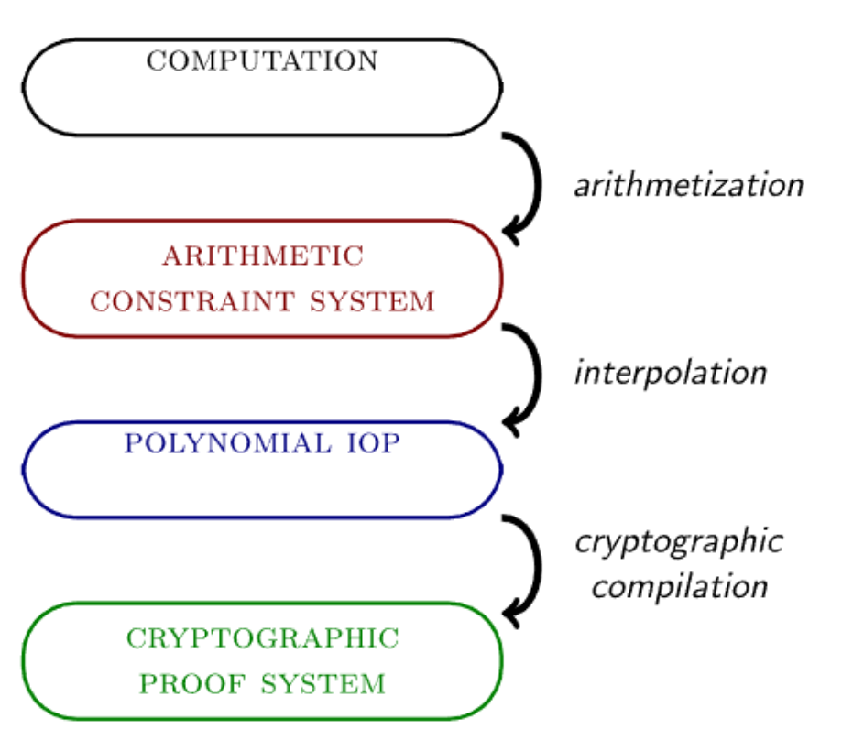
Mechanics
The computation includes: a program, an input and an output.
This computation is transformed into a set of equations or tuples, including various constraints.
They are then represented in terms of univariate polynomials.
Use a proof system to commit and verify.

Slide 7
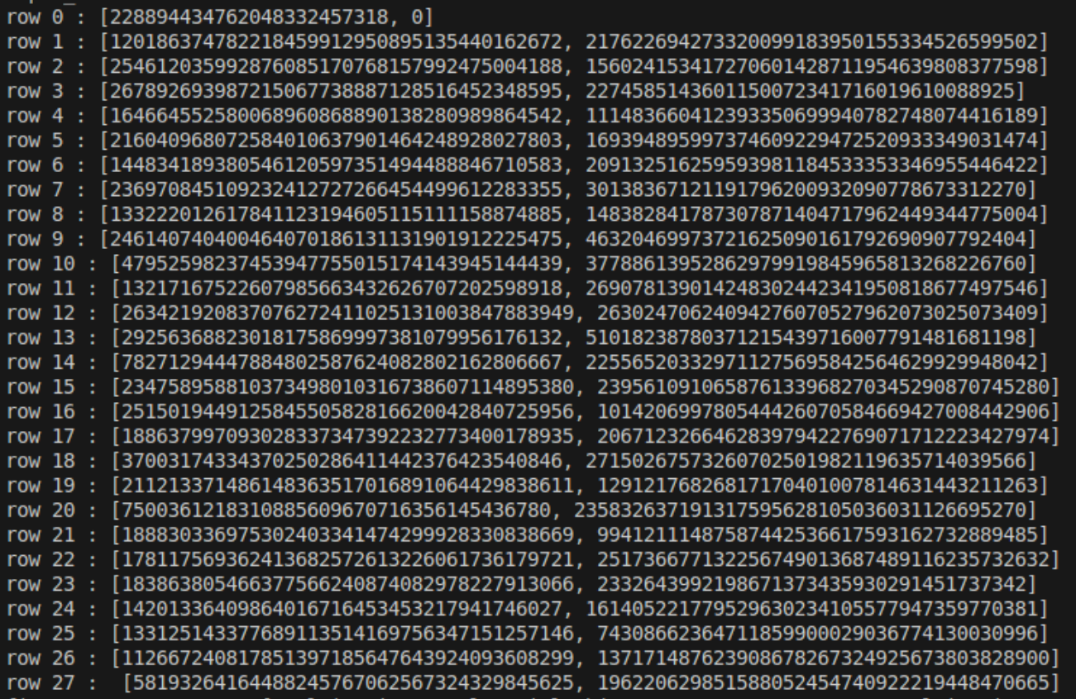
Mechanics
Arithmetization
A program consists of instructions, each of which changes the state.
State is a list of registers.
Consider the trace of program as a table, with T rows and w columns, each row represents the state at a given time.
For example:
Program is a Rescue function
Input: 228894434762048332457318
Output: 58193264164488245767062567324329845625

Slide 8
Mechanics
Arithmetization
Define at least 2 constraints: boundary constraints and transition constraints.
Boundary constraints: at the start or at the
end of the computation, an indicated register
has a given value.
Transition constraints: any two consecutive state tuples evolved in accordance with the state transition function.

Slide 9
Mechanics
Arithmetization
Boundary constraints: set B of triple (r,c,e) ∈ {0,…,T} × {0,…,w−1} × F
EX: (0, 1, 0), (T, 0, h)

Slide 10

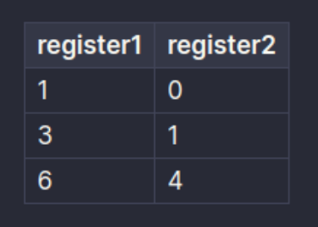
Mechanics
Arithmetization
Transition constraints: a list of polynomials that capture the transition of each register.
EX:
There are multivariate polynomials.
EX:

Slide 11
Mechanics
Arithmetization
At the end of this step, prover have:
Boundary constraints: set of tuples (r, c, e)
Transition constraints: multivariate polynomials
Trace: the table.

Slide 12
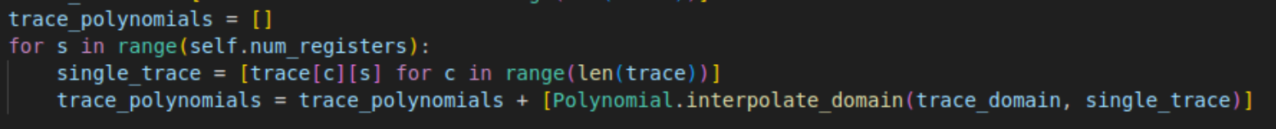
Mechanics
Interpolation
Interpolate the trace into trace polynomials, which are w univariate polynomials.
Each polynomial P_i(x) represents the state of register i-th.

Slide 13
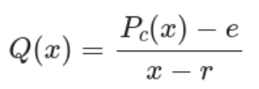
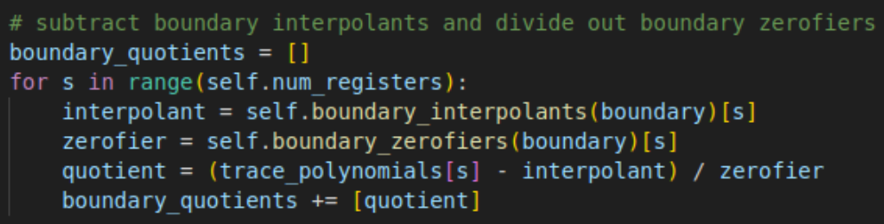
Mechanics
Interpolation
Boundary: (r, c, e) To validate that register c has value e at time r ⇔ validate that P_c(r) = e
⇔ there exists a quotient polynomial:
So, we transform boundary constraints into w boundary quotients, which are univariate.

Slide 14
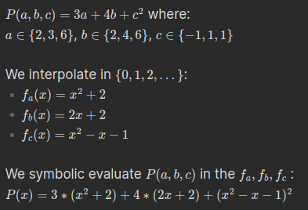
Mechanics
Interpolation
Transition constraints: w multivariate polynomials
Symbolic evaluation: instead of evaluating the multivariate polynomial in a tuple of scalars, it is evaluated in a tuple of univariate polynomials. The result is not a scalar, but a new univariate polynomial.
Example

Slide 15

Mechanics
Interpolation
Transition constraints: w multivariate polynomials
Symbolic evaluation: instead of evaluating the multivariate polynomial in a tuple of scalars, it is evaluated in a tuple of univariate polynomials. The result is not a scalar, but a new univariate polynomial.
Evaluate transition constraints in the trace polynomials P_i(x) to get w transition polynomials.
Transform transition polynomials into transition quotients.

Slide 16
Mechanics
Interpolation
At the end of this step, we have:
w boundary quotients (univariate polynomials)
w transition quotients (univariate polynomials)

Slide 17
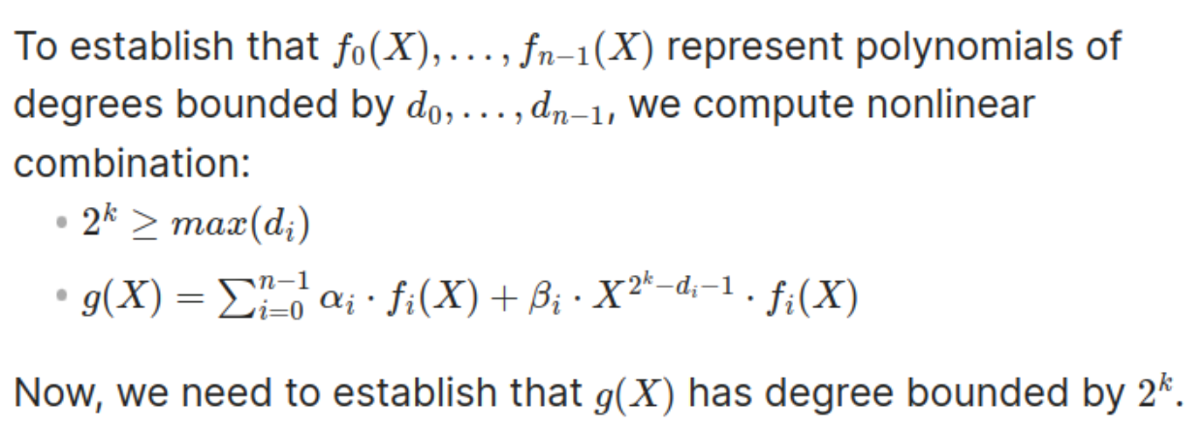
Mechanics
Cryptographic compilation
Instead of using FRI to commit all quotient polynomials individually, we use a nonlinear combination method to merge all polynomials into a single entity.
Nonlinear combination:

Slide 18
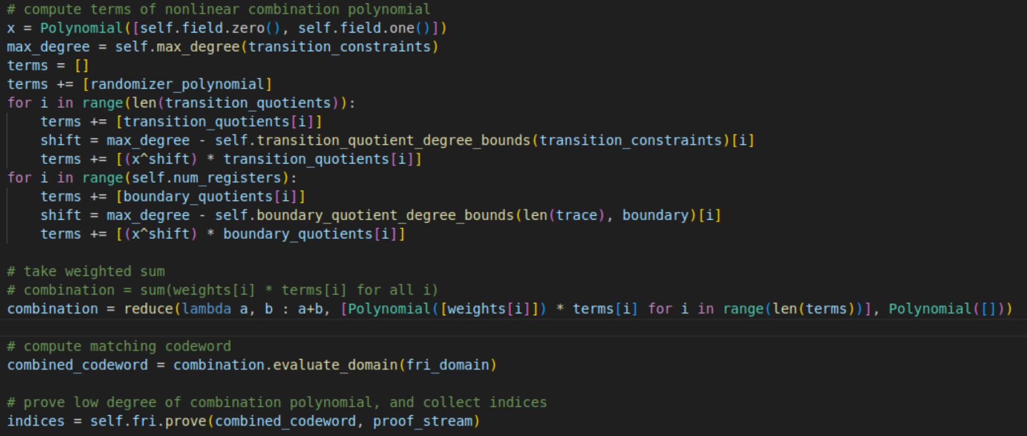
Mechanics
Cryptographic compilation
Instead of using FRI to commit all quotient polynomials individually, we use a nonlinear combination method to merge all polynomials into a single entity.
We combine 2*w univariate polynomial into only one univariate polynomial g(x).
Commit g(x) via FRI

Slide 19
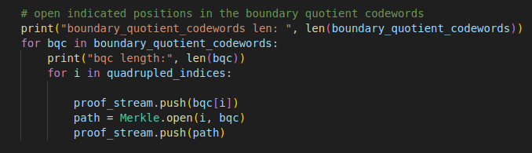
Mechanics
Cryptographic compilation
How can the prover confirm that the way he uses the nonlinear combination is correct?
=> Open indicated positions in the boundary quotient codewords
=> Verifier can verify leafs of combination polynomial herself.

Slide 20
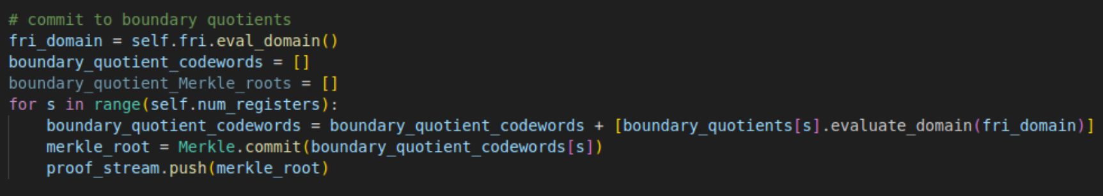
Mechanics
Cryptographic compilation
Use FRI to commit g(X).
Need to commit w boundary polynomials via Merkle Tree to establish that the way we use nonlinear combination is correct.
To achieve Zero-knowledge, we needs to add some randomizers to the trace.

Slide 21
Mechanics
Cryptographic compilation
At the end of this step, we commit:
g(X) (combination polynomials) via FRI
w boundary quotients via Merkle Tree and indicated position’s openings.

Slide 22
Mechanics
Verification
Input: proof, transition constraints, boundary constraints
Verify combination polynomial g(X) via FRI proof.
Verify boundary quotients codeword openings
Verify leafs of combination polynomial:
Verifier compute transition constraints values by herself and then compute combination value.
Compare combination value with leaves of g(x) in FRI.

Slide 23
03
Demo
https://github.com/aszepieniec/stark-anatomy

Slide 24
04
Future Works

Slide 25
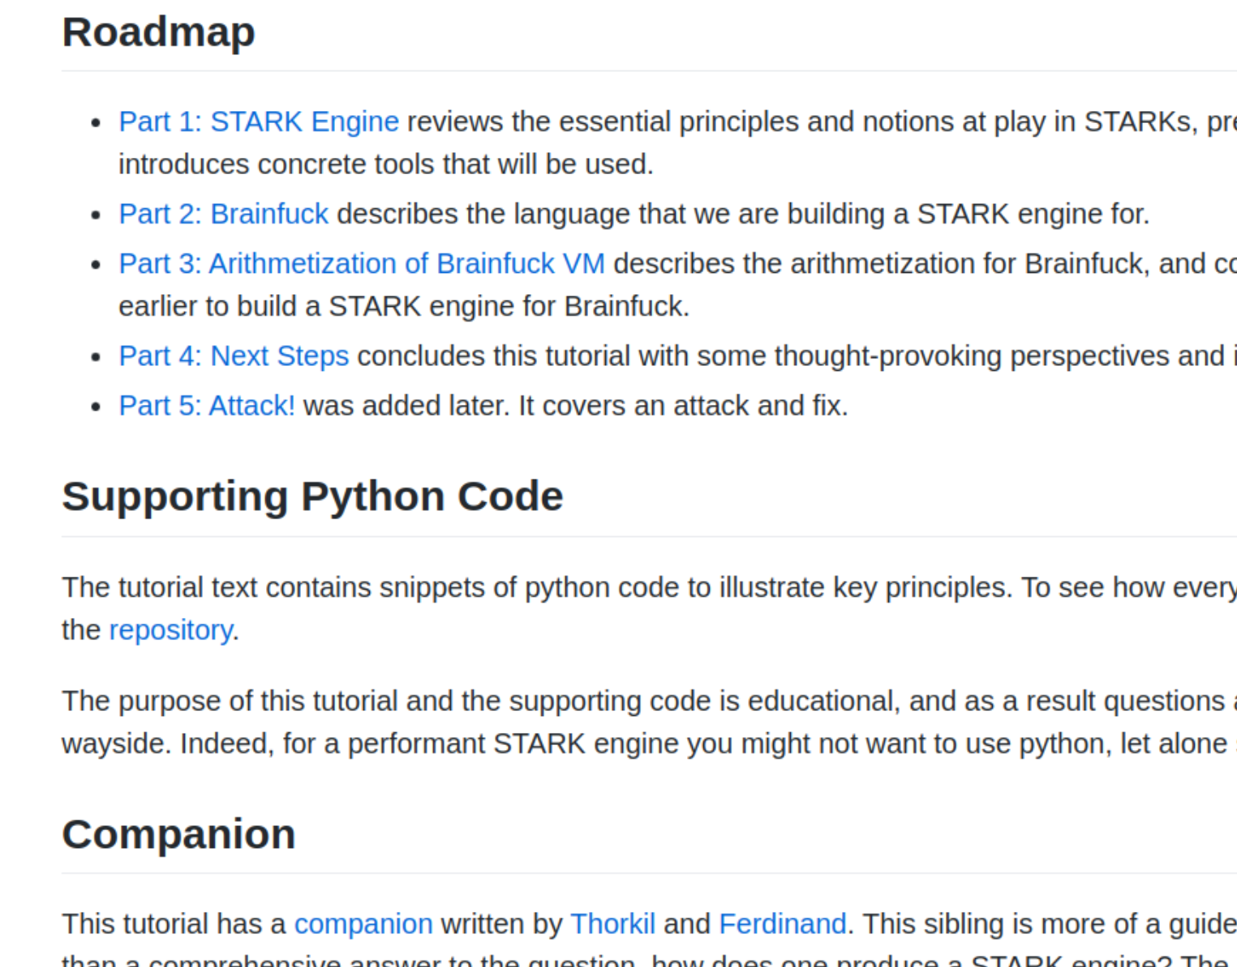
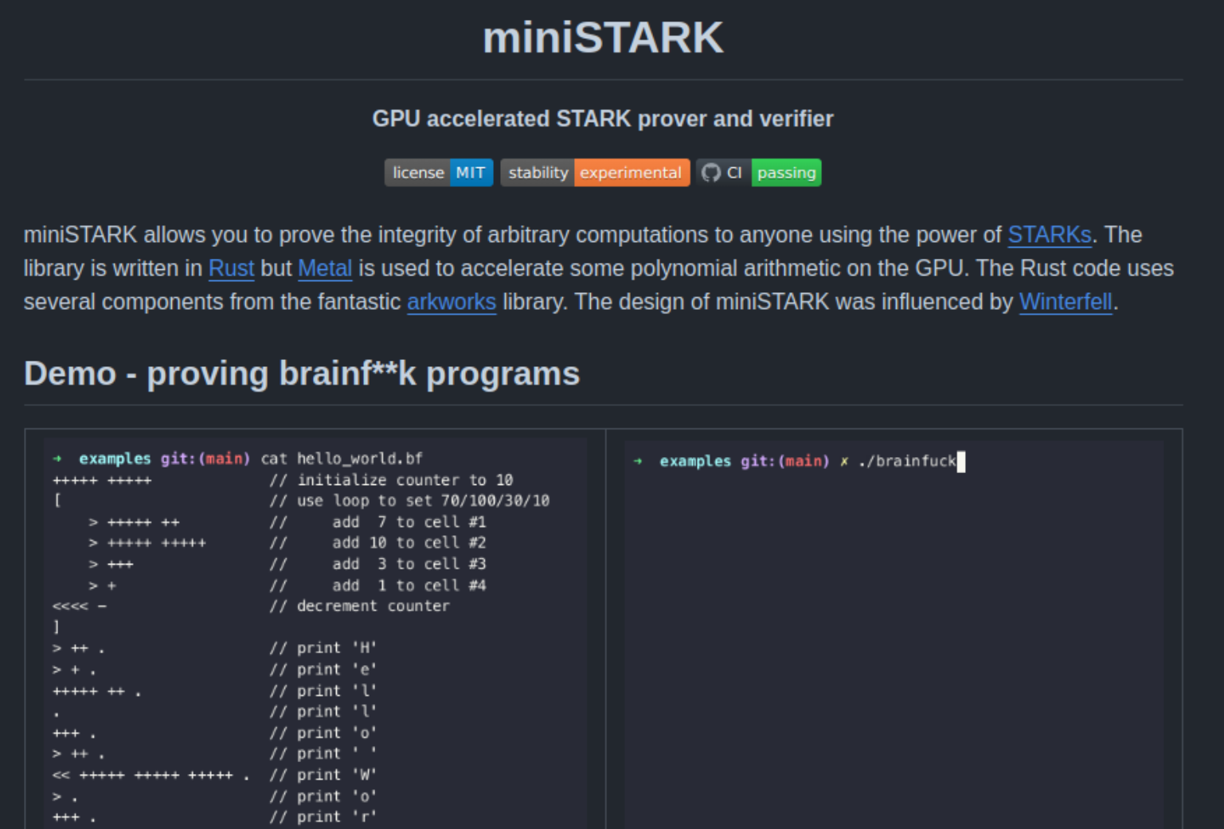
Future works
How to improve the speed of STARK.
Learn how to design a Turing-complete zk-STARK engine: virtual machine, prover, and verifier.
Dive into miniStark codebase.

Slide 26
Reference
Stark Anatomy: https://aszepieniec.github.io/stark-anatomy/
StarkMath series: https://medium.com/starkware/tagged/stark-math
Andrew Milson: https://www.linkedin.com/in/amilson?originalSubdomain=au

Slide 27
05
Thanks for listening

Slide 28
05
Q&A

